Slide 1




SmartClass AI: Democratizing Education Through Automation
Let AI Carry the Grind. Let Teachers Teach.
AI for Good · Nova Legacy
UN SDG 4: Quality Education

Slide 2




CONTENTS
01
The Global Teacher Workload Crisis
02
The AI for Good Opportunity
03
Four Automation Engines
04
Impact & Technical Innovation
05
Scaling for Global Impact

Slide 3


01
The Global Teacher Workload Crisis

Slide 4


The Global Reality — A Crisis in Numbers
UNESCO estimates 69 million new teachers are needed by 2030 to achieve universal primary and secondary education (SDG 4.c). Meanwhile, teachers worldwide spend 40%+ of their time on non-instructional tasks: tracking assignments, organizing materials, reviewing homework, and managing parent communications.
In messaging-based classrooms across 100+ countries — whether WeChat, WhatsApp, or Telegram — parents flood groups with homework in inconsistent formats (PDF, JPG, voice notes). Teachers manually sift through hundreds of messages nightly.
Evening review: viewing images one by one, marking work, replying — 2+ hours daily. Late-night submissions from working parents disrupt sleep and well-being.
During class: teachers track who submitted, whether work is complete, and which students are falling behind — all manually, all invisible to school administrators.
Afternoon: teaching groups flood with class notes, PDFs, answer keys, event photos — all manually saved and categorized by overwhelmed staff.
This is not a local problem. It is a global barrier to SDG 4 — teachers everywhere are drowning in repetitive busywork instead of teaching.

Slide 5
Four Global Pain Points — Barriers to SDG 4
🎯 SDG 4.c · Workload Tracking
🎯 SDG 5 · Unequal Burden
Unstructured messaging platforms need manual copy-paste to compile. 5+ classes × 50 students × 3 subjects = massive data, error-prone, 1–3 hours daily. Rural teachers with larger classes suffer most.
Students submit anytime; teachers must respond fast. Women, who make up 70%+ of primary teachers globally, bear the heaviest after-hours burden. Missed items are buried — and so is teacher well-being.
🎯 SDG 10 · Material Inequality
🎯 SDG 9 · Infrastructure Gap
Notes, homework, PDFs, photos only live in ephemeral chat — files expire, unsearchable, easily lost. In low-resource settings, lost materials mean lost learning. The digital divide widens when content isn't preserved.
Most school IT only handles timetabling. Real classroom work — tracking, reviewing, organizing — remains manual. No affordable tools exist for the 85% of schools in developing regions.
Teachers want to teach. The system buries them in busywork. This is solvable.

Slide 6
02
The AI for Good Opportunity

Slide 7

Why Existing Solutions Fall Short
The Gap in Today's Tools
Messaging apps are the de facto classroom for billions. Dedicated LMS platforms (Google Classroom, etc.) have <15% adoption in developing countries — they require infrastructure, training, and device upgrades. AI grading systems handle only structured multiple-choice, not real homework photos. The tools exist, but they miss where education actually happens.
A Massive Unmet Need
No existing solution automates teaching workflows inside the messaging platforms where learning actually happens — WeChat, WhatsApp, Telegram. These platforms serve 4+ billion users, yet no AI layer bridges the gap between chat conversations and structured educational data.

Slide 8

Our Innovation: Messaging + AI = Democratized Education
What Makes Us Different
Auto-read messages, download images & PDFs, AI classify, AI review, Excel tracking, 24/7 daemon — all at near-zero cost, running on any standard laptop. No cloud dependency, no per-student fees, no new hardware.
Built for Equity
Zero-switch integration — parents and students use the messaging app they already have. 5-minute setup, AI assistant 24/7. Designed to work where infrastructure is weakest: offline-capable, low-bandwidth, any language.

Slide 9
SmartClass vs. Existing Solutions
Capability | Existing Tools | SmartClass AI
Auto-read messaging content | ❌ None | ✅ Full support
Auto-download images & PDFs | Partial | ✅ Strong
AI content classification | Virtually none | ✅ Hunyuan AI
AI homework review | App required | ✅ In-chat dual-model review
Auto Excel attendance stats | ❌ None | ✅ Fully automated
24/7 daemon automation | ❌ None | ✅ Yes
Cost | High | Near-zero (local)
The first AI system that works where teachers and students already are — their messaging apps. No migration, no training, no cost barrier.

Slide 10
03
Three Automation Engines — for SDG 4

Slide 11


Engine 1: Check-ins → Excel, Zero-Error Tracking
Automated Workflow
Saves 1.5 hours per teacher daily. Error rate <0.3%. Supports retroactive tracking — no student falls through the cracks. When scaled, this frees millions of teacher-hours for actual instruction.
Impact for SDG 4
export.py + update.py auto-read messaging content, identify students, generate structured CSV/Excel reports. Teachers receive complete attendance records each morning — zero manual effort. Schools gain visibility into participation gaps across gender, geography, and socioeconomic groups.

Slide 12
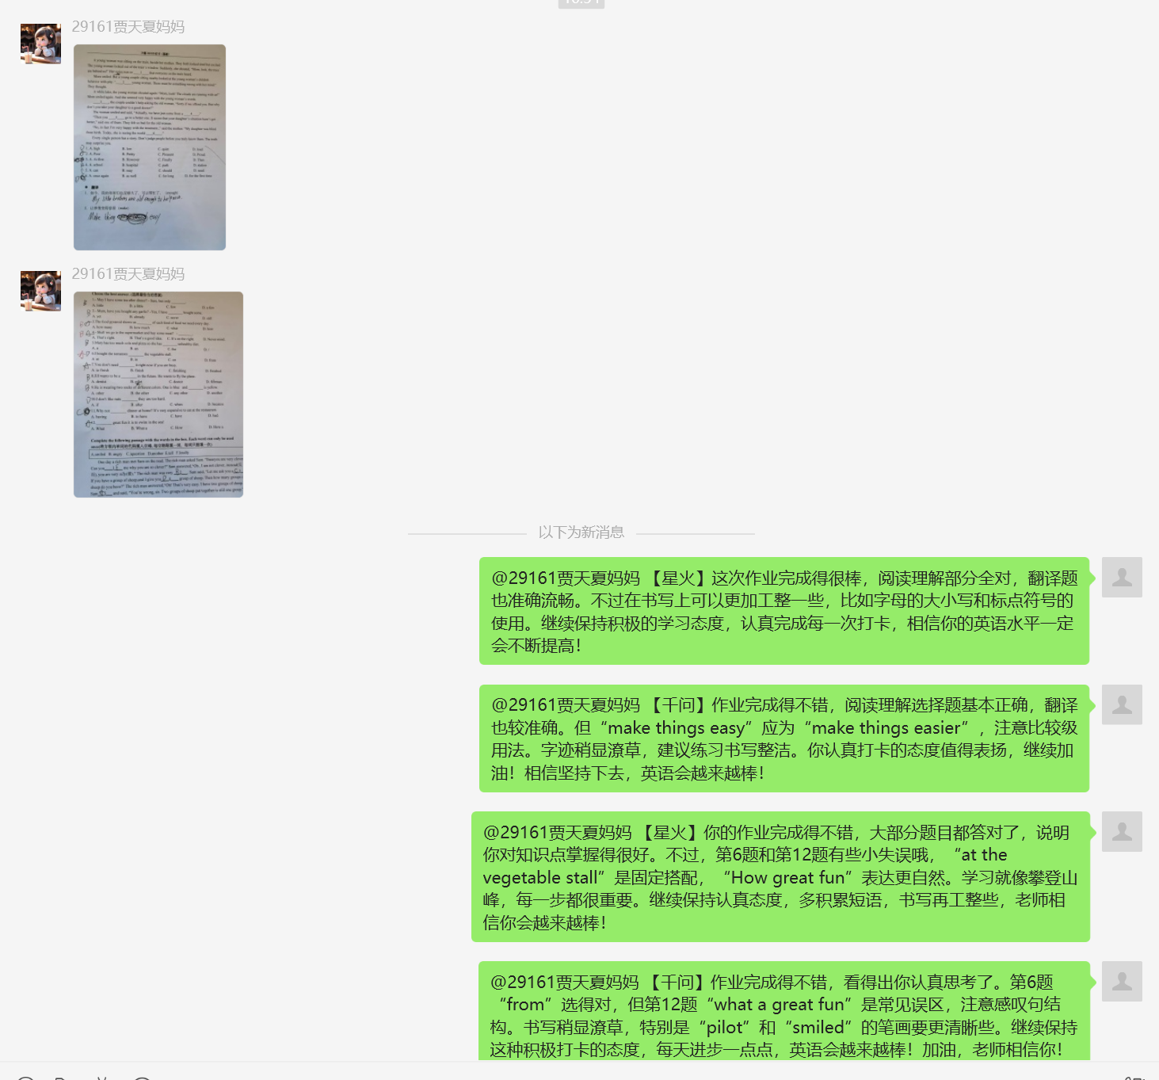
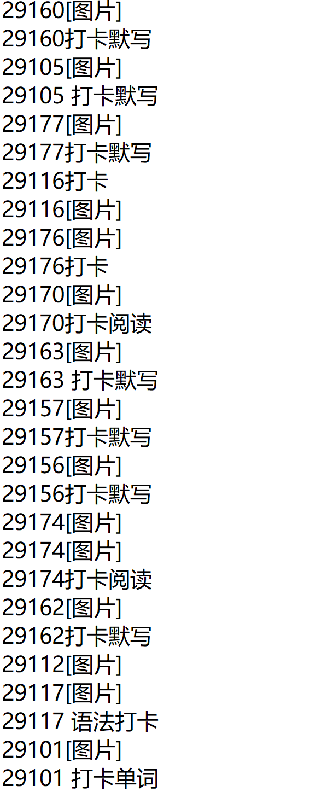
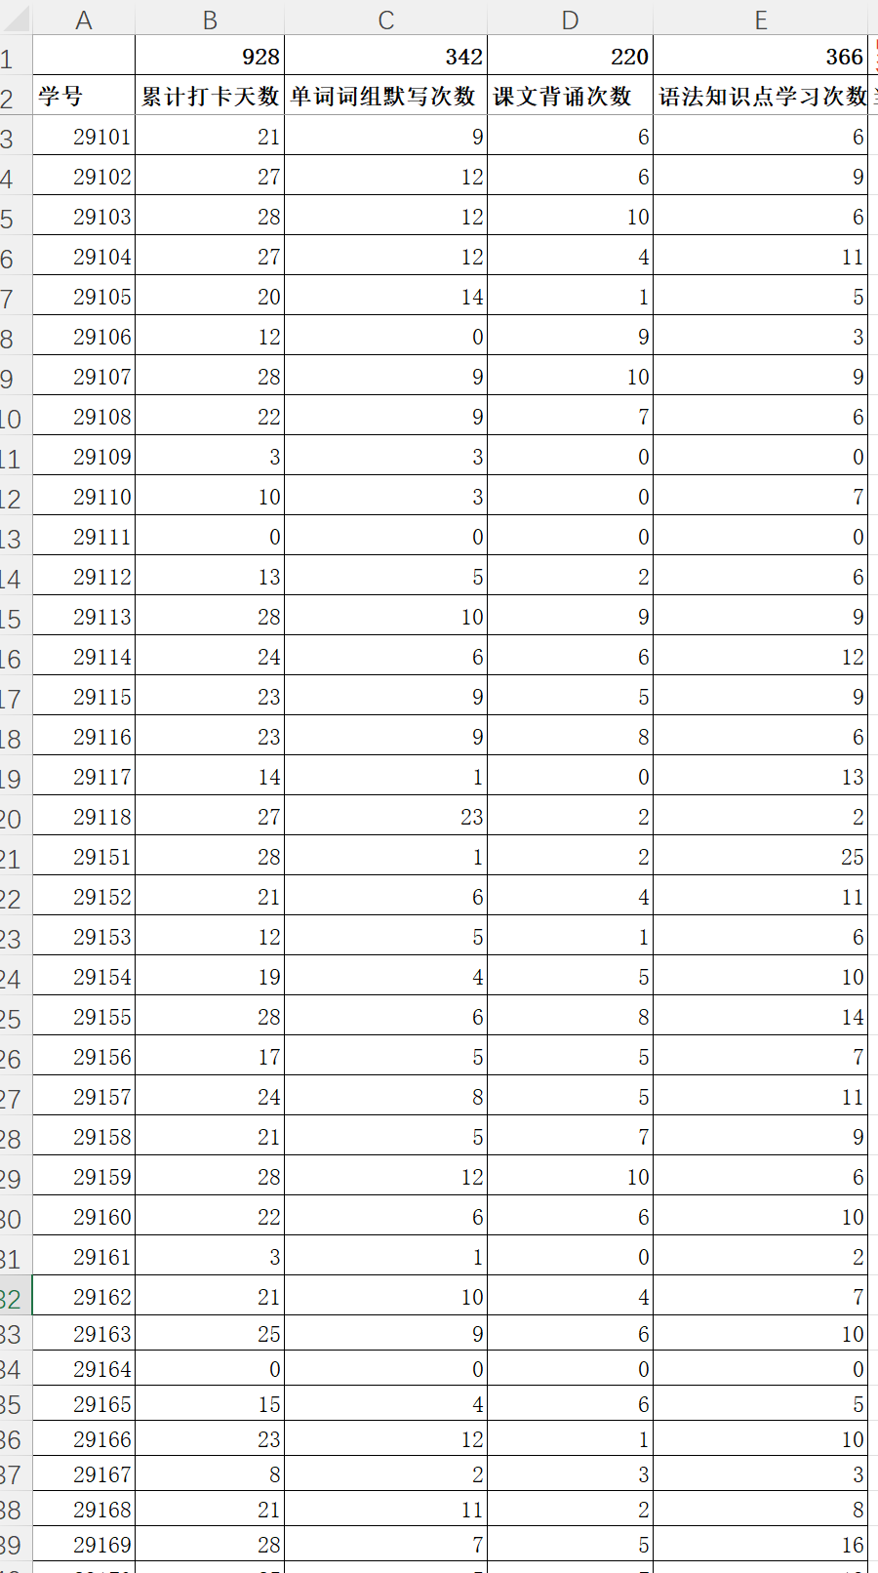
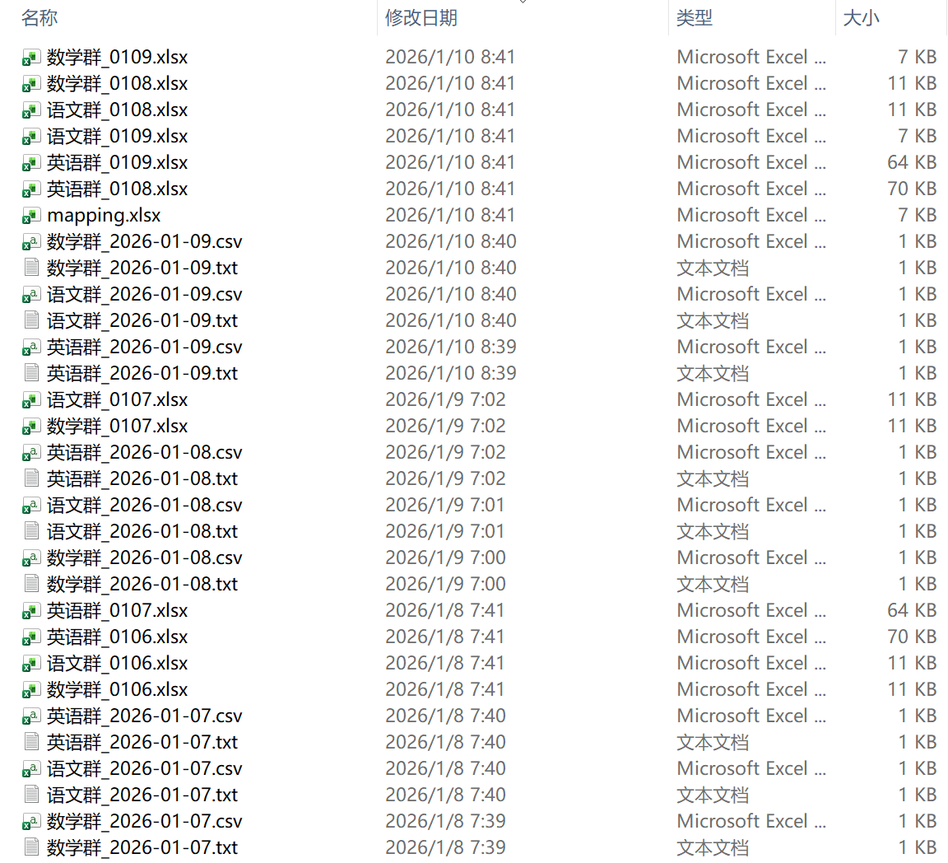
Example: From Chaotic Group Chat → Clean Statistics
Group chat submissions
AI content extraction
Same-day statistics
Monthly summary report

Slide 13

Engine 2: AI Classification & Archiving
Archiving Features
Storage & Retrieval
download.py uses dual-modal AI to auto-classify files by Group-Student-Topic. Deduplication, timestamping, and keyword tagging enable instant search — transforming ephemeral chat into a permanent, organized knowledge base.
No more scrolling through chat history. Everything stored locally — offline, compliant, secure. In low-connectivity areas, this means learning materials survive even when the internet doesn't.

Slide 14
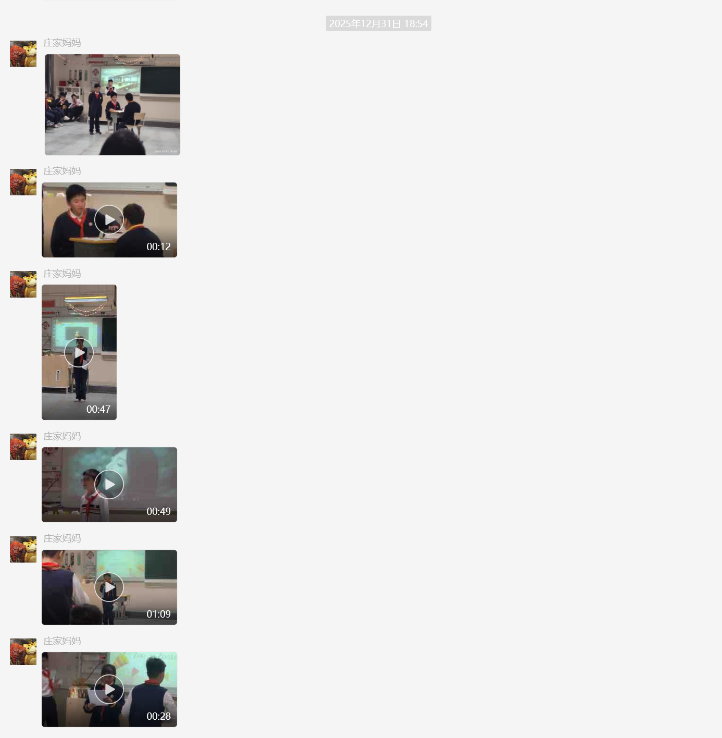
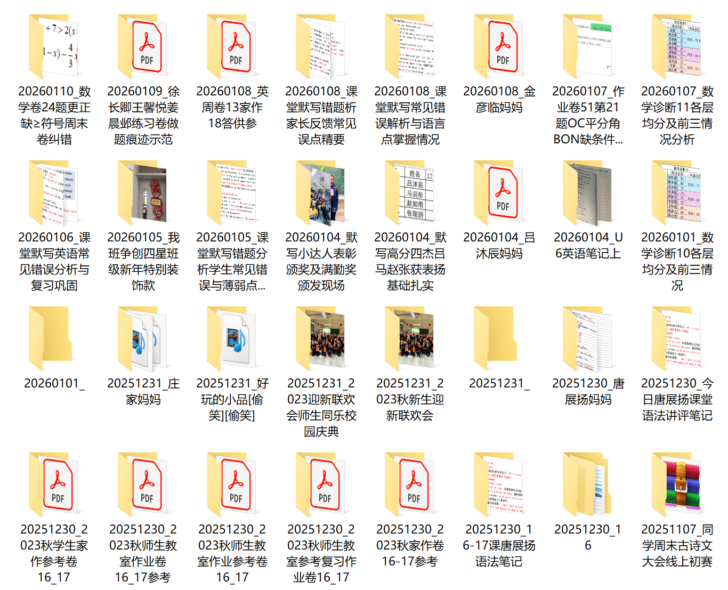
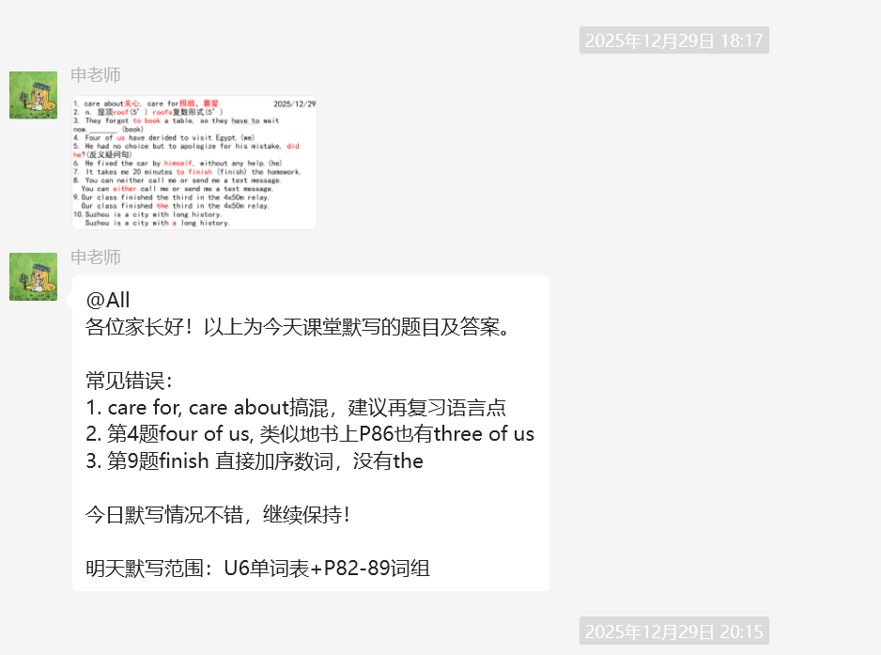
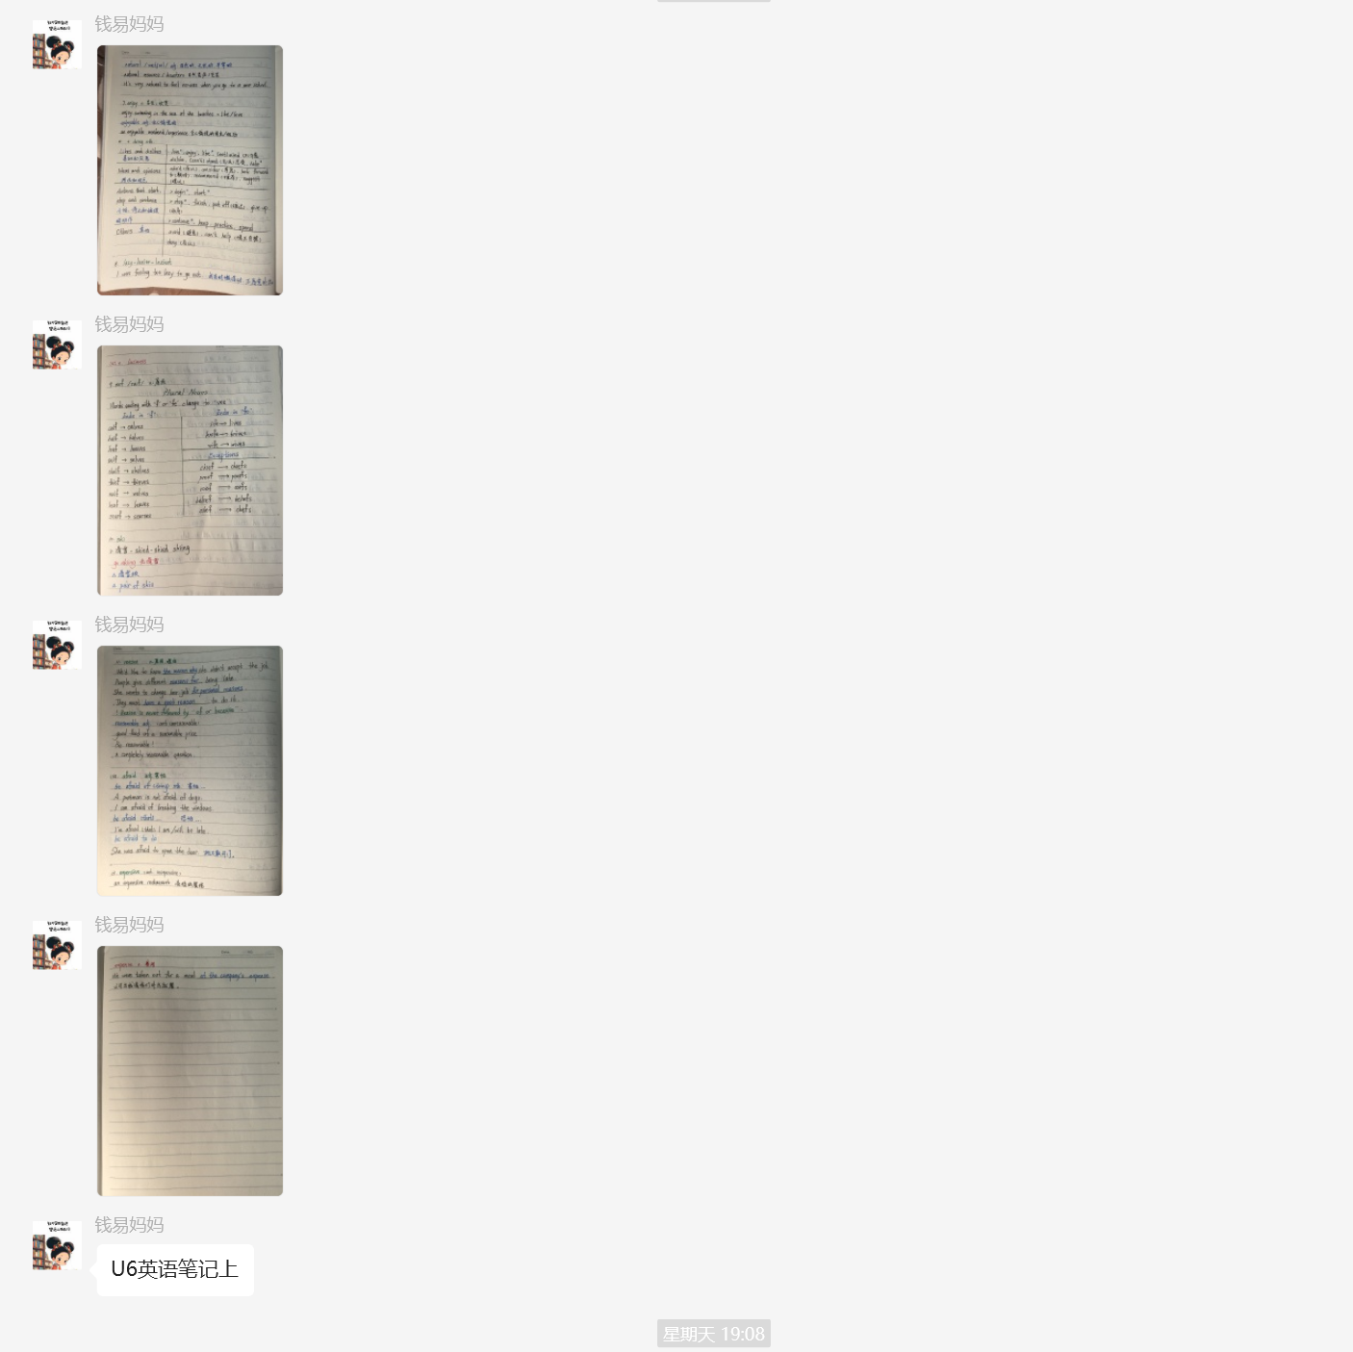
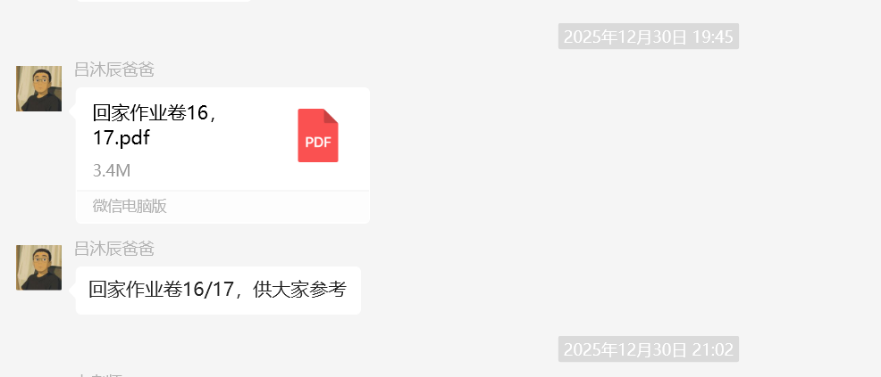
Example: AI Multi-Modal File Classification in Action
AI understands images & context — automatic classification

Slide 15

Engine 3: Multi-Model AI Homework Review
Review Process
daemon.py monitors 24/7. One model (Spark) handles precise error correction; another (Qwen-VL) generates encouraging, personalized feedback. Results are merged and auto-replied — every student gets a response, not just the loudest voices.
Night Mode
Night mode queues reviews silently — protecting teacher well-being, a critical SDG 4.c priority for retaining qualified educators.
Measured Impact
Tested on 200+ homework images: 96% parent satisfaction, review time 2 hrs → 5 min. Consistent quality, reproducible at scale. Teachers reclaim their evenings for lesson planning — or for their own families.

Slide 16
04
Impact & Technical Innovation

Slide 17
Proprietary Architecture — Offline · Low-Cost · Open
Integrates with existing school management systems via open API
daemon
Application
export & update
checkin
download
AI Foundation
safewechat
message
chechinstats
wxname2studentid
qwenvlreview
sparkreview
sparkchat
Middleware
wxauto
Qwen-VL
Spark
Hunyuan
OS
Windows 10
Hardware
Intel AIPC

Slide 18

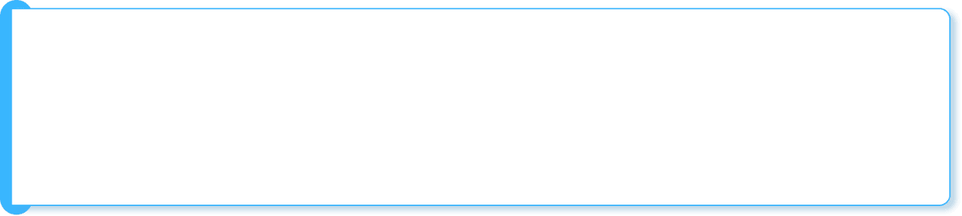

Stable · Efficient · Proven
Feature Highlights
Auto Excel: xlwings-triggered recalculation — reliable results
Error Recovery: night queue + window anomaly self-healing
Desktop Automation: wxauto + safewechat for full stability
Performance
OCR-Free Multimodal AI: Spark + Qwen — native image understanding
Fast Diff: MessageDiffFast O(n) — instant new-message detection
WebSocket Concurrency: custom message receiver for scale
“The AI explains more gently than I do — and more thoroughly.”
“No more late nights verifying attendance.”
“Review time: 2 hours down to 10 minutes.”
Real-World Validation
Deployed in live classrooms for months with near-zero intervention. Proven mature, reliable, and ready to scale across diverse educational settings.

Slide 19
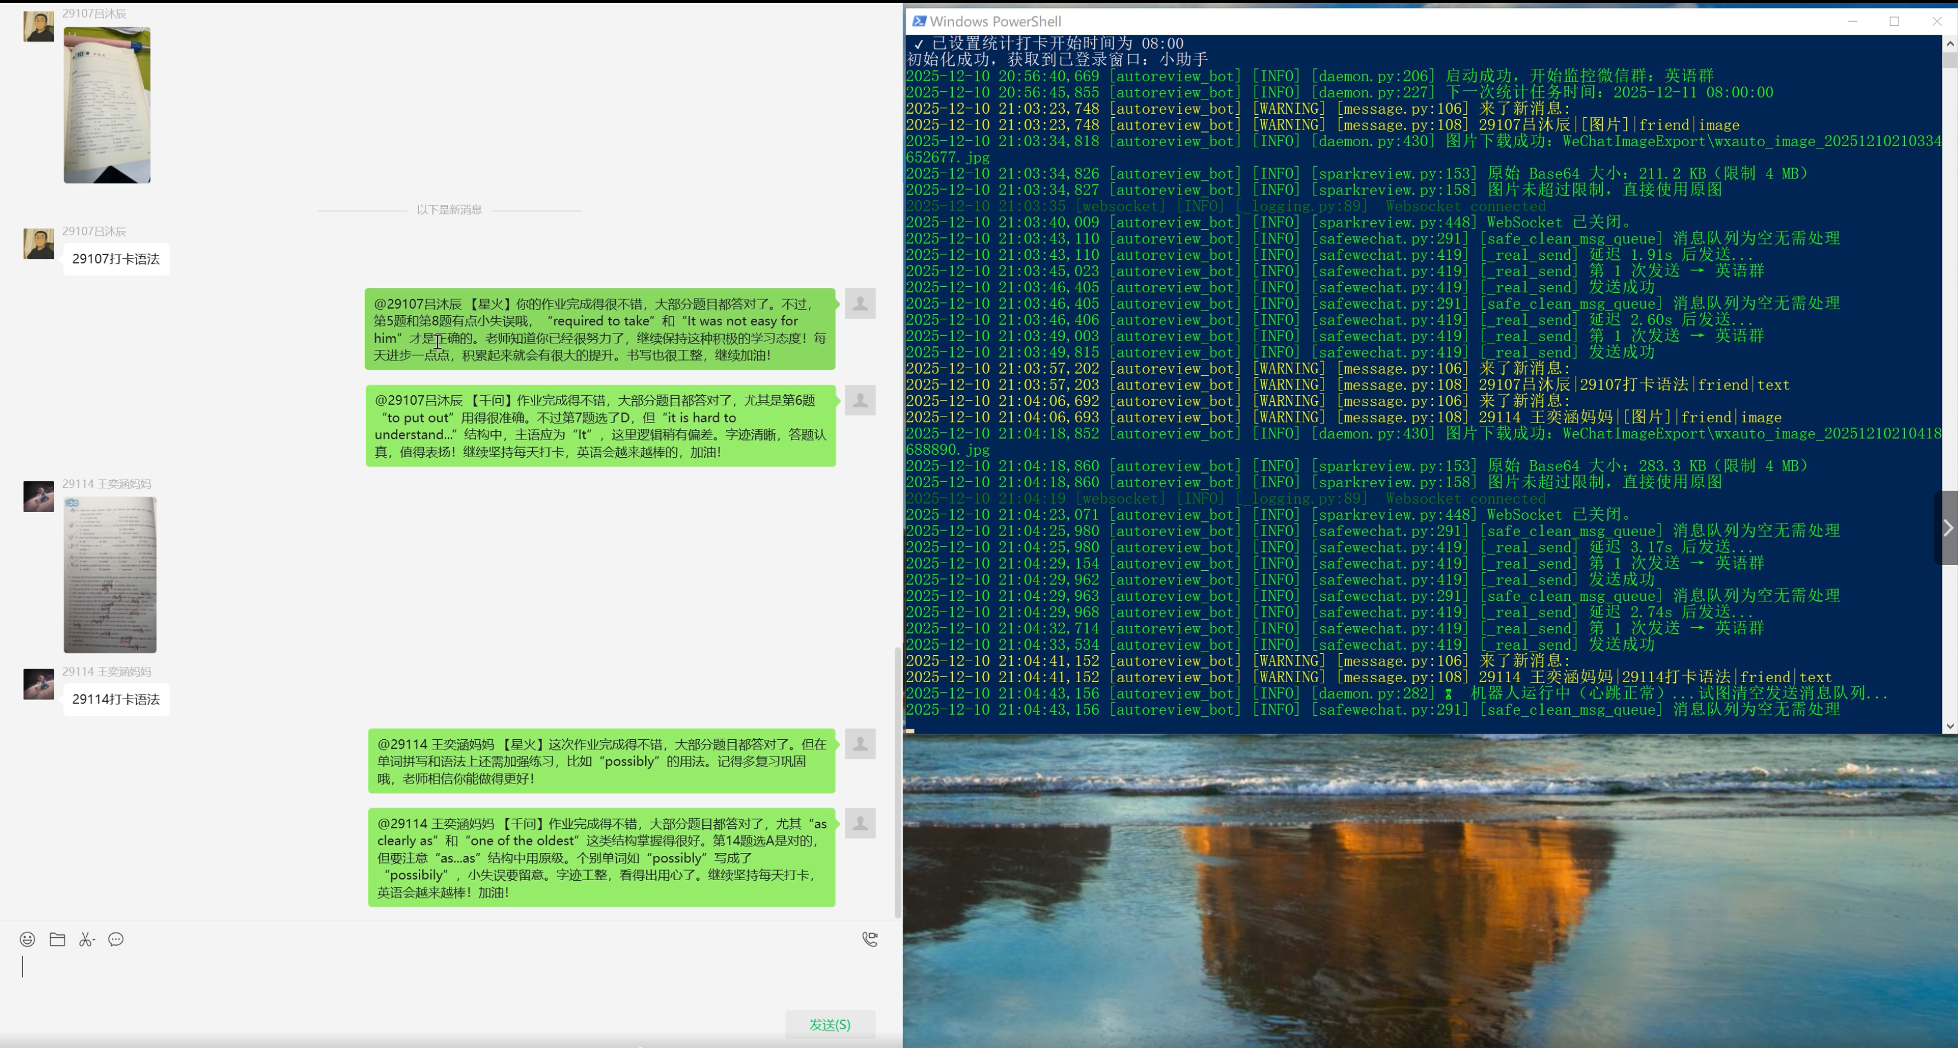
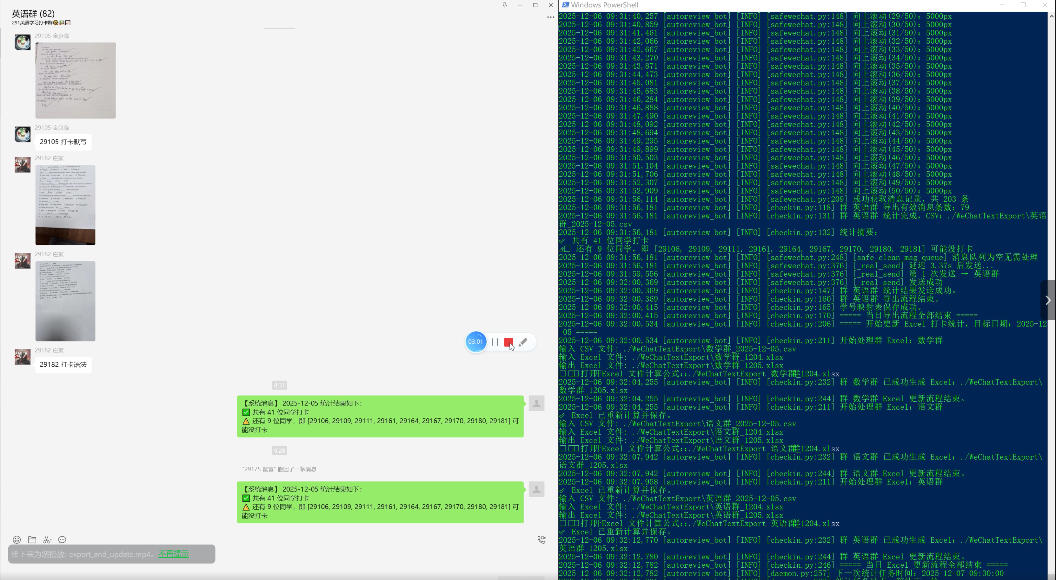
Interface Preview
Check-in Statistics in Daemon Mode
AI Review in Daemon Mode

Slide 20
🎯 Why This Matters — Aligned with the UN SDGs
The Global Education Paradox
Our Approach
Teachers spend 40%+ of time on admin, not teaching → 69M new teachers needed by 2030 (UNESCO)
Automate repetitive tasks with AI → recover 1.5 hrs/teacher/day
AI handles analysis & feedback → every student gets timely response
Teachers focus on what only humans can do → mentoring, inspiring, connecting (SDG 4.c)
Time back to education. Energy back to students. → SDG 4.1: quality learning outcomes
We are not building a tool. We are building a digital workforce for every teacher — especially those in underserved communities.

Slide 21
05
🎯 Scaling for Global Impact — SDG 17

Slide 22
Short-Term Roadmap (12 Months)
Feature Expansion
Deployment
Multi-subject review models: Math, Science, Language Arts, Social Studies
Auto-generated student growth portfolios with learning analytics
Real-time learning equity dashboard — track gaps by gender, region, SES
Class knowledge graph — identify systemic learning gaps at scale
Voice & video review — for low-literacy and oral-language communities
On-premise deployment — no cloud dependency, works in offline environments
OPEA with localized LLMs + Intel AI accelerators — sovereign AI for every school
Offline AI on campus networks — compliant with national data sovereignty laws
Tiered access control — grade, subject, and classroom-level data governance
Build the first "messaging-native AI teaching assistant" — deployable on any platform, in any language.
AI as every teacher's digital co-pilot — not another burden.

Slide 23
Long-Term Vision — 2030 & Beyond
Ultimate Vision
Call to Action
By 2030: Deploy in 1 million classrooms across 50+ countries. Recover 100 million teacher-hours annually. Support all major messaging platforms — WeChat, WhatsApp, Telegram — and 30+ languages. Become the invisible AI layer that makes every classroom more equitable.
We call on the UN community, governments, and education partners: help us bring this digital workforce to every school that needs it. Prioritize deployment in underserved regions — rural, conflict-affected, low-resource — where the teacher workload crisis hits hardest.
We have redesigned the teacher's workday with AI — so every child, everywhere, gets the attention they deserve from a teacher who is not exhausted, but empowered.

Slide 24

Together, let’s make quality education accessible to every child.
Thank You

